Slide 1
Crop rotation schedular
Harshitha rollno 25A31A05BM
Amrutha rollno 25A31A05CG
Tejaswi rollno 25A31A05cm
Raja rollno 25A31A05BM
Under the guidance of manas sir

Slide 2
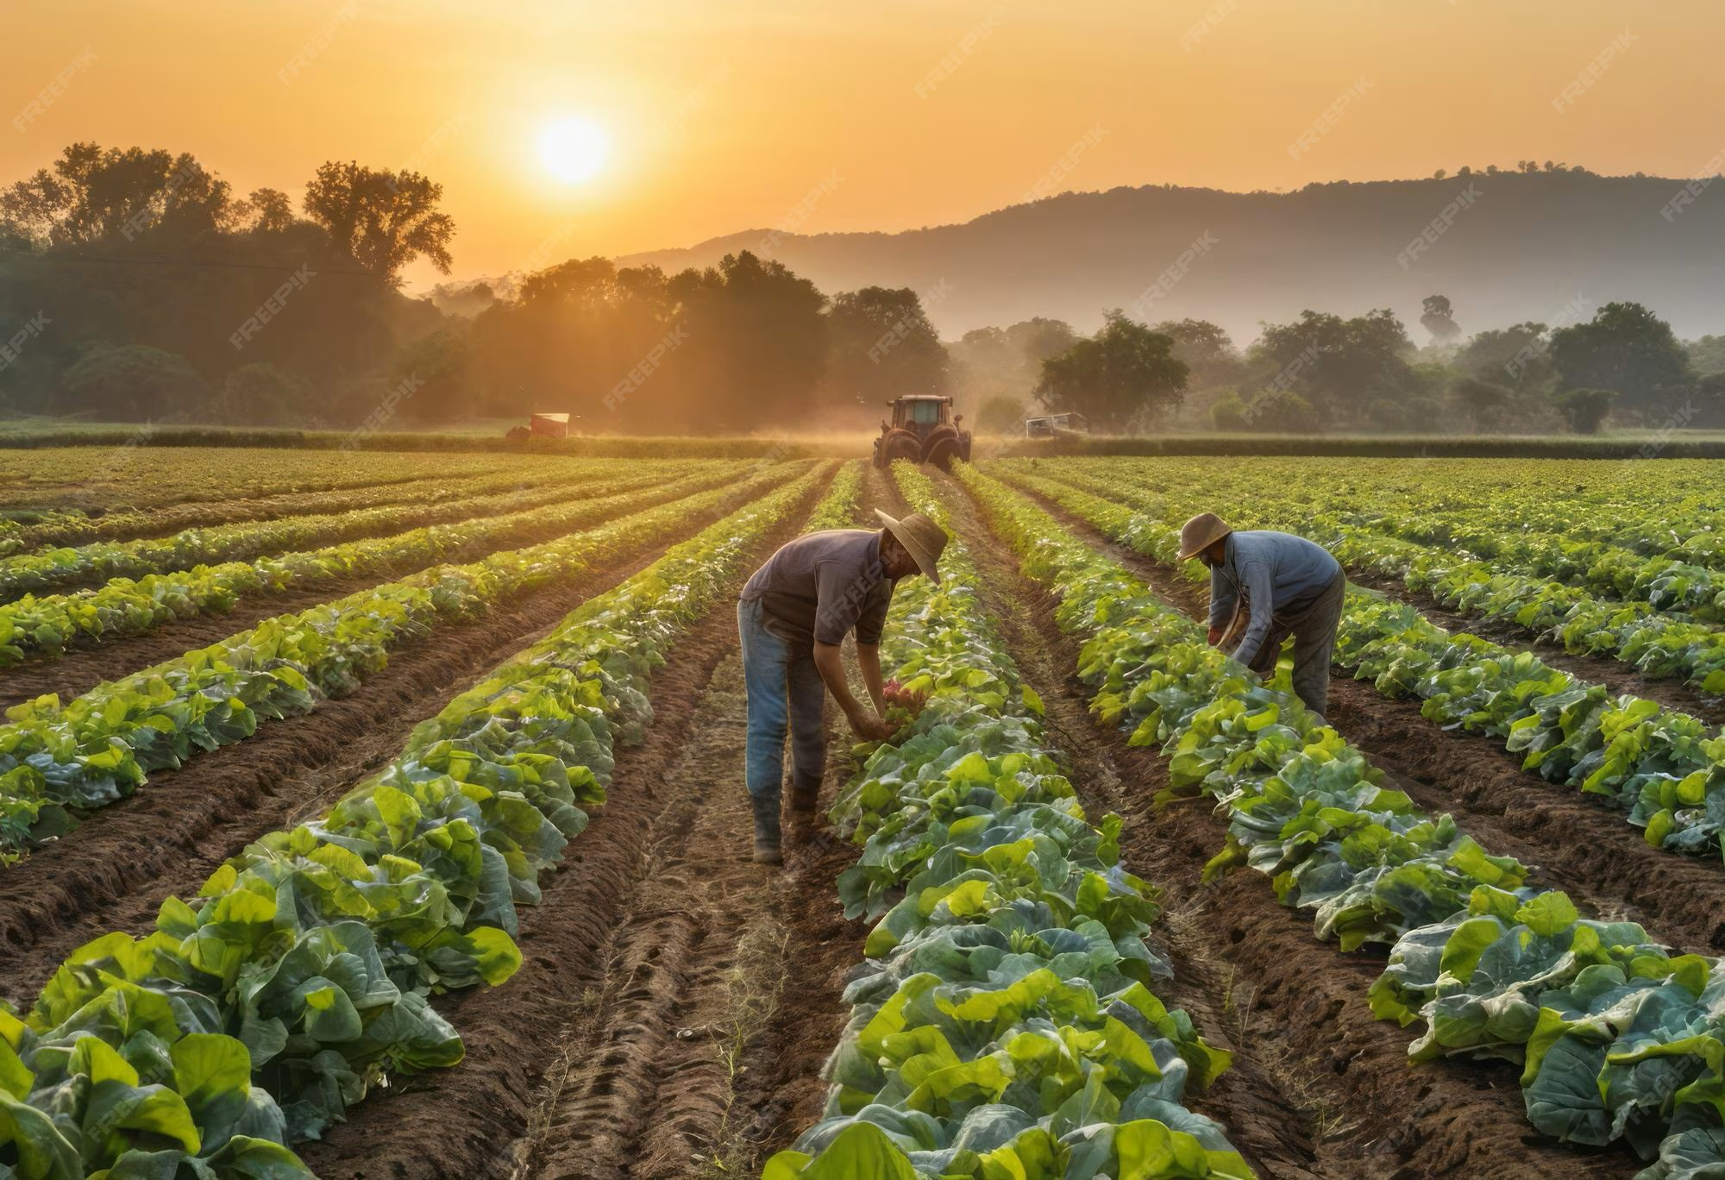
Definition
Crop rotation is the practice of growing different crops in a planned sequence on the same land. A scheduler helps in planning which crop to grow and when.

Slide 3

Need for Crop Rotation
Crop rotation is important because it helps maintain soil fertility, prevents nutrient depletion, and improves soil structure. It controls pests, diseases, and weeds by breaking their life cycles. It also increases crop yield, ensures better use of resources, and supports environmentally sustainable farming.

Slide 4

Principles of Crop Rotation
Grow different crops in a sequence instead of the same crop repeatedly.
Alternate deep-rooted and shallow-rooted crops.
Include leguminous crops to improve soil fertility (nitrogen fixation).
Rotate crops with different nutrient requirements.Avoid growing crops of the same family consecutively.
Follow crops that help control pests, diseases, and weeds.
Maintain a proper balance between soil-improving and soil-exhausting crops.

Slide 5

Advantages of Crop Rotation Scheduler
Advantages of Crop Rotation Scheduler (Key Points)
Improves soil fertility and maintains nutrient balance
Increases crop yield and productivity
Reduces pests and diseases naturally
Controls weed growth effectively
Enhances soil structure and health
Ensures efficient use of water and resources

